Slide 1
Heuristic Evaluation Function
Zainab Yousuf

Slide 2
Content
Informed/Heuristic based Search
Heuristic Evaluation Function

Slide 3
Informed/Heuristic based Search
So far we have looked into procedures that search the search space in an uninformed manner which is costly with respect to either time, space or both.
We now focus on a few techniques that search the solution space in an informed manner using something which is called a heuristic.
Such techniques are called heuristic based searches or informed searches.

Slide 4
Informed/Heuristic based Search
The basic idea of a heuristic search is that rather than trying all possible search paths, you try and focus on paths that seem to be getting you closer to your goal state using some kind of a “guide”.
Recall the example of the mouse searching for cheese. The smell of cheese guides the mouse in the maze, in other words the strength of the smell informs the mouse that how far is it from the goal state. Here the smell of cheese is the heuristic and it is quite accurate.

Slide 5
Heuristic
You generally can't be sure that you are really near to your goal state in a search space.
However, heuristics may provide a good guess to move in search space.
Heuristic is some sort of guess/hint that can be represented by a numeric value.
It may represent winning chances in a game
It may represent the cost of a route in a map etc.
It must be noted that heuristics don’t always give us the right guess, and hence the correct solutions.
In mouse maze problem consider that the maze has fences fixed along some of the paths through which the smell can pass. Our heuristic might guide us on a path which is blocked by a fence, hence again the heuristic is misguiding us.

Slide 6
Heuristic
AI problem solver employs heuristics in two basic situations:
A problem because of ambiguities may not have exact solution.
A problem may have an exact solution, but the computational cost of finding it may be prohibitive.
Heuristics attack this complexity by guiding the search along the most “promising” path through the space thus eliminating unpromising states and their descendants from consideration.
It is useful to think of heuristic algorithms as consisting of two parts:
The heuristic measuring function: To estimate heuristic value
An algorithm that uses it to search the state space.

Slide 7
Heuristic Evaluation Function

Slide 8
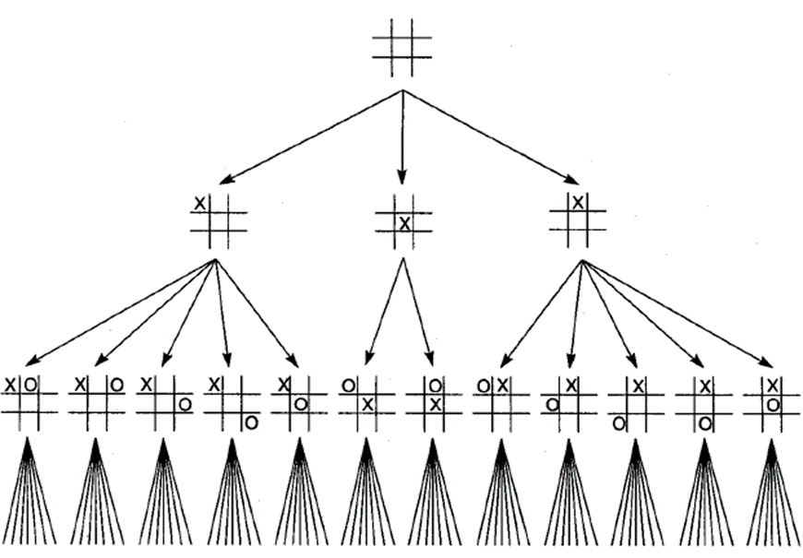
Heuristic Example-Tic-Tac-Toe
In a complete search space there are 9! Possible state to search, through heuristics this search can be reduced. Symmetry reduction decreases the search space.

Slide 9
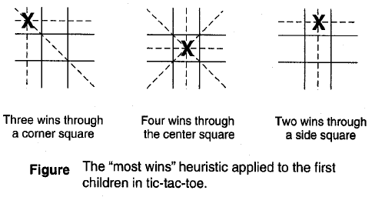
Heuristic Example-Tic-Tac-Toe

Slide 10
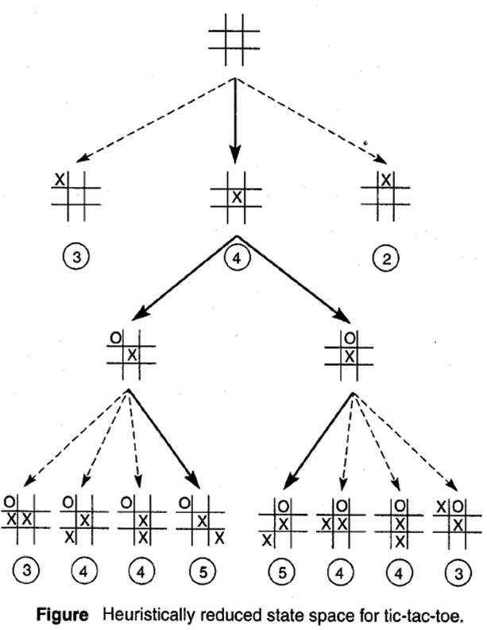
Heuristic Example-Tic-Tac-Toe

Slide 11
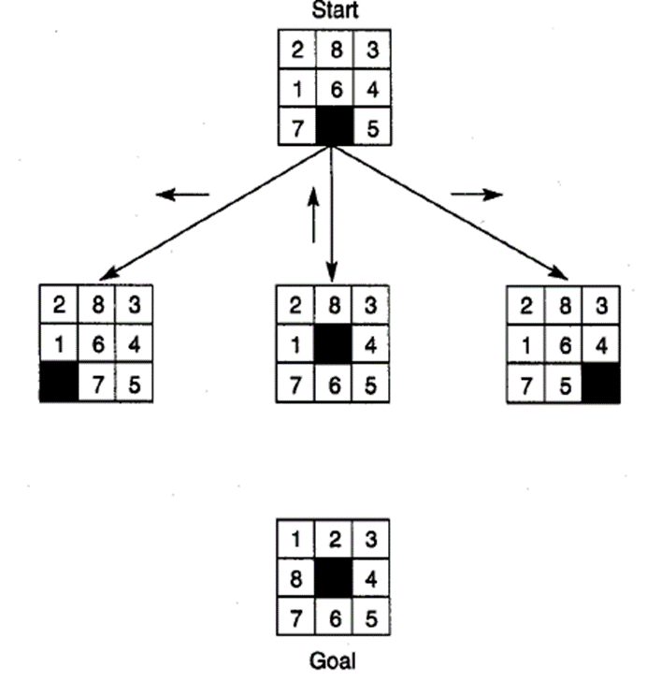
Heuristic Example-8 Puzzle

Slide 12
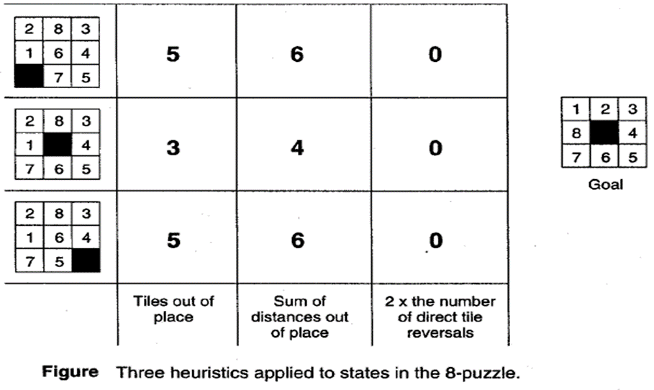
Heuristic Example-8 Puzzle

Slide 13
Thank You

